Slide 1

AGENTIC AI & CLOUD ENGINEERING
Srikar Kotra

Slide 2





INSPIRATION
AGENDA
Introduction
"The first rule of any technology used in a business is that automation applied to an efficient operation will magnify the efficiency.“ — Bill Gates
Enhancing Cloud Operations
Cost Optimization
Impact
Journey and Roadmap
Notes:
Datadog integration, redaction – 2 agenda, Enhancing Cloud Operations – 3 projects (1 project cloud assistant-data dog integration,datadog redaction, optimizing latency, evaluation of models 2 proj Right sizing - Creating DB schemas 3 Agentic AI Anomaly Detection projectData pull from different Anomaly health sourcesDevelop an ML Model for false alarm detection and threshold validationCreating agents - multiple agents included in the imagePOC - Crew AI vs Langgraph), cloud assistant-optimizing model latency, evaluation

Slide 3



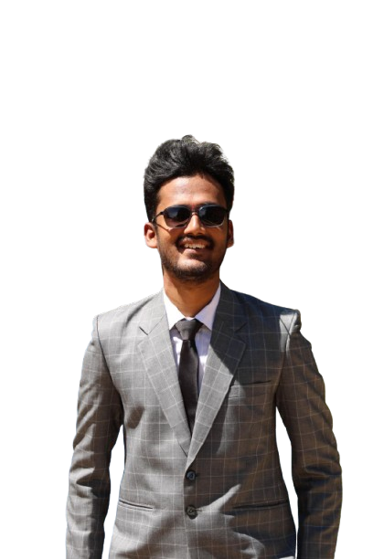


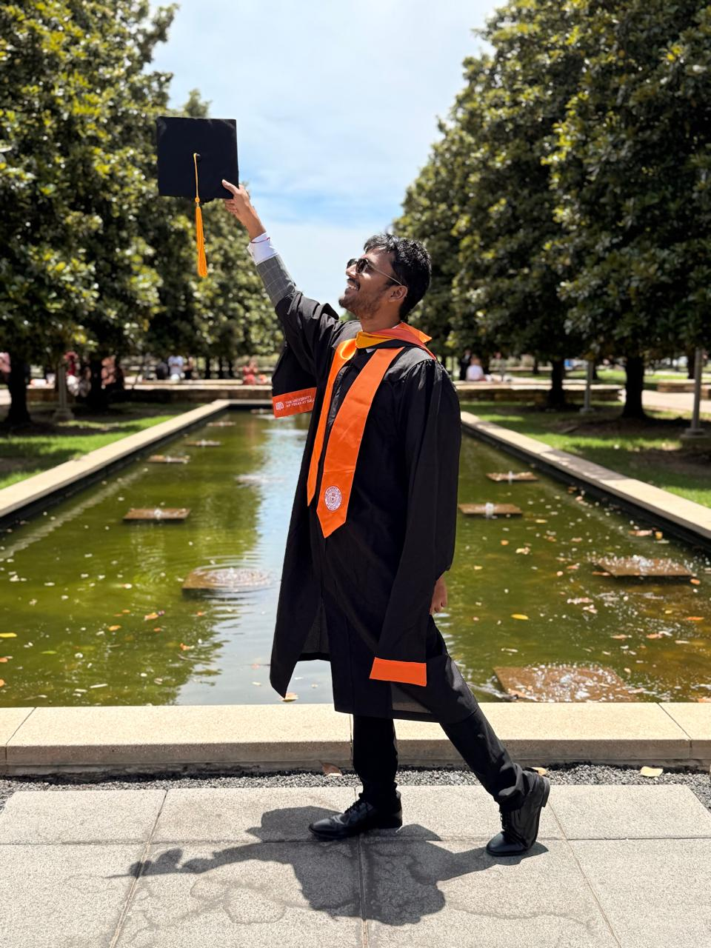

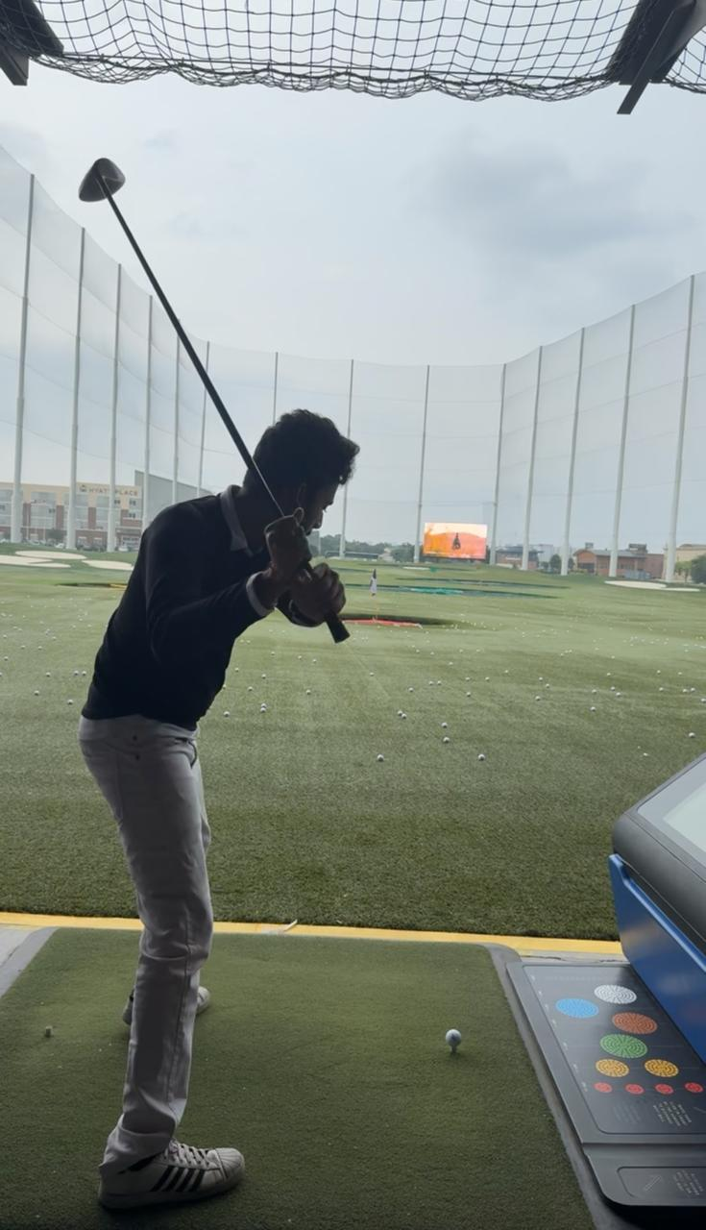
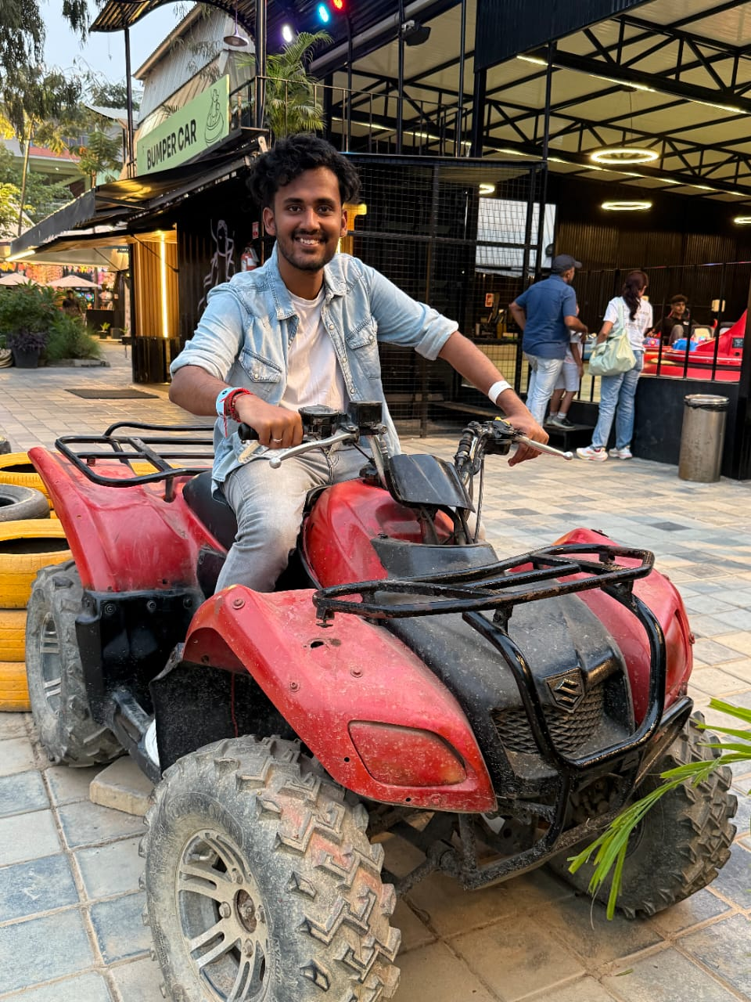
Introduction x
Srikar Kotra
MS in Computer Science, University of Texas at Dallas Graduated May 2025 Hometown: India
Software Engineer Intern
Software Engineering Intern, Team: Data Protection
Manager: Hailey Phillips, Mentor: DeVynn Mingo
Football: The only place where I slow down… but only to score goals. Gaming: If there’s a leaderboard, I’m aiming for the top. Staying Active: Energy level: 200%. Sitting still? Not my thing.
"I’m so active that even my coffee can’t keep up with me."

Slide 4

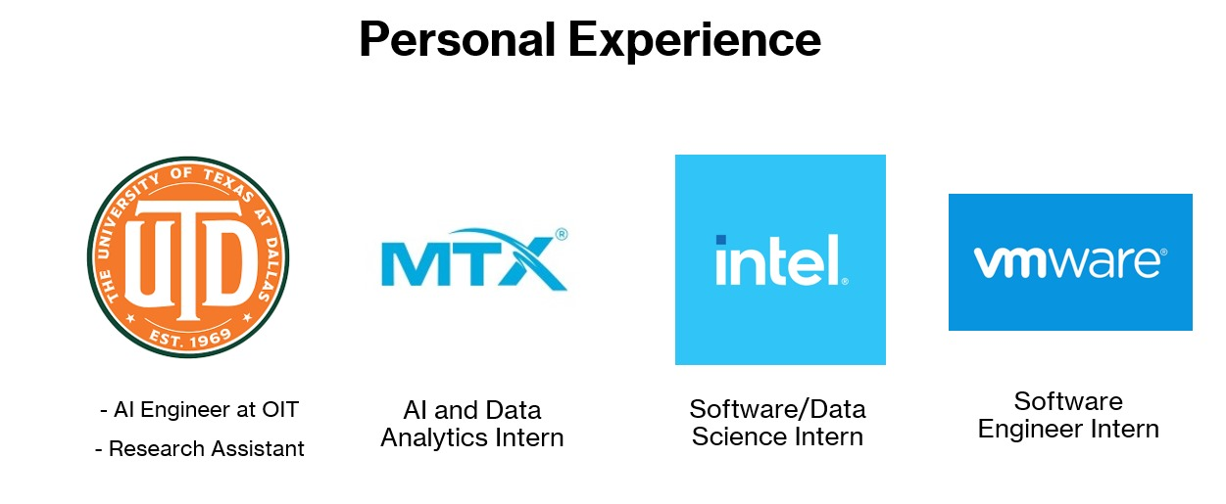
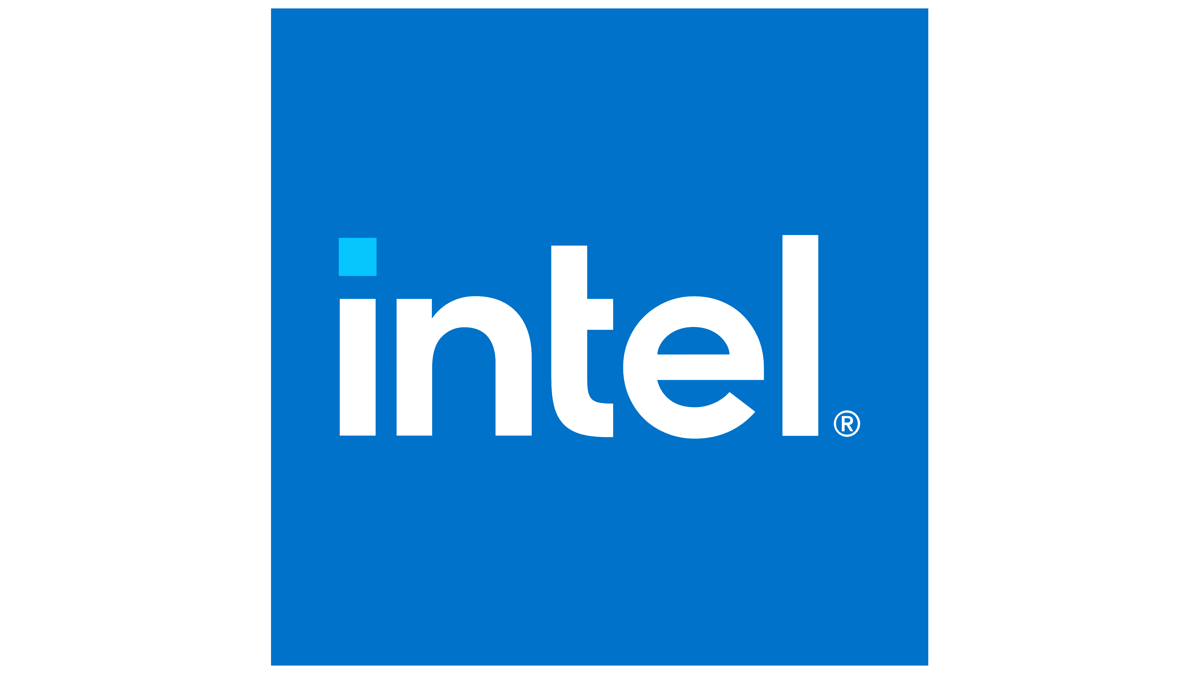
Introduction x
Work Experience
AI Engineer at OIT Research Assistant
AI and Data Analytics Intern
Software/Data Science Intern
Software Engineer Intern

Slide 5
Introduction x

Slide 6






Introduction x
AGENDA
Introduction
Enhancing Cloud Operations
Cost Optimization
Impact
Srikar Kotra
MS in Computer Science, University of Texas at Dallas Graduated May 2025 Hometown: India
Journey and Roadmap
Software Engineer Intern
Software Engineering Intern, Team: Data Protection
Manager: Hailey Phillips, Mentor: DeVynn Mingo
Education
Football: The only place where I slow down… but only to score goals. Gaming: If there’s a leaderboard, I’m aiming for the top. Staying Active: Energy level: 200%. Sitting still? Not my thing.
Work @ CBRE
"I’m so active that even my coffee can’t keep up with me."
Hobbies
Fun Fact

Slide 7

Software Engineering Internship
Srikar Kotra
June 18 – August 26

Slide 8









Agenda
Introduction
"The first rule of any technology used in a business is that automation applied to an efficient operation will magnify the efficiency.“ — Bill Gates
Enhancing Cloud Operations
Cost Optimization
Impact
Journey and Roadmap

Slide 9

About Me
1
Name: Srikar Kotra
Title: Software Engineering Intern
Manager: John Gideon
Mentor: Thilak Jayachandran
Team: Cloud, EA, Developer Services
Education: University of Texas at Dallas (UTD)
Graduation: May 2025
Hometown: Dallas
Major: Computer Science
Hobbies: Soccer, Badminton, Travel
Notes:
So a little bit about me, My name is Chirag Godha and I am working under Phani on the DotCom Team. I am completing my bachelors in Computer and Data Science at Rutgers University in my hometown of New Jersey. And outside of work and school I love to play basketball, work towards my health goals and learn to cook new recipies. Now let jump into the projects

Slide 10
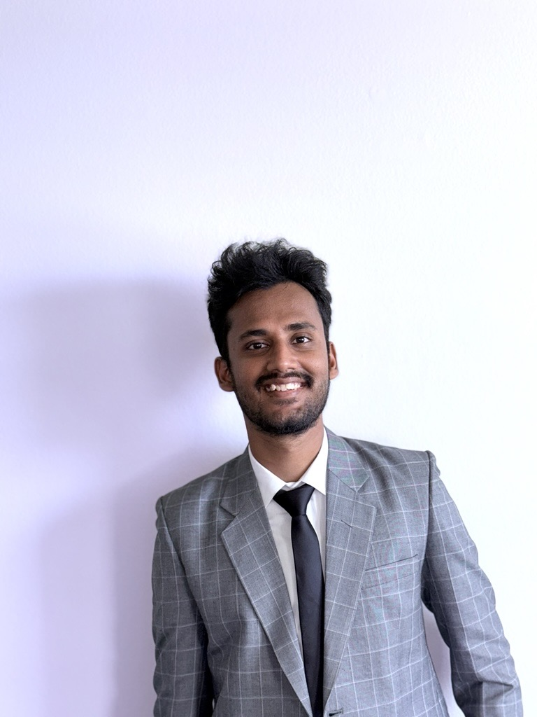
Experience
AI Engineer
AI and Data Analytics Intern
Software Engineering Intern
Software Engineering Intern
Notes:
So a little bit about me, My name is Chirag Godha and I am working under Phani on the DotCom Team. I am completing my bachelors in Computer and Data Science at Rutgers University in my hometown of New Jersey. And outside of work and school I love to play basketball, work towards my health goals and learn to cook new recipies. Now let jump into the projects

Slide 11
Projects Introduction
Cloud Transformation
Team
Your Intelligent Cloud Assistant
Agentic AI Cloud Rightsizing Agent
Agentic AI Anomaly Detection
Leverage SNOW ticket history insights to resolve issues efficiently.
Instantly search CBRE’s cloud knowledge base for fast, relevant answers.
AI-powered solution that continuously analyzes past 30 days of resource utilization across cloud assets.
Provides optimized right-sizing recommendations for cloud infrastructure.
Agentic AI powered solution that alerts anomalies to save costs
Provides optimized recommendations for cloud infrastructure around 4 cloud platforms
My Focus
Latency (Responses from 50s -> <6s)
No monitoring

Slide 12
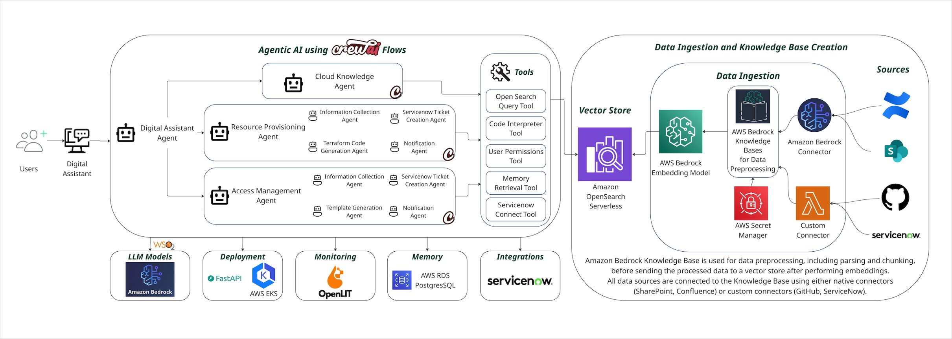

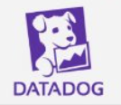

My Internship Focus
Optimizing Latency
LLM Observability Integration and Redaction
Observability
Monitoring
Logging
Tracing
Clustering
Redacting

Slide 13
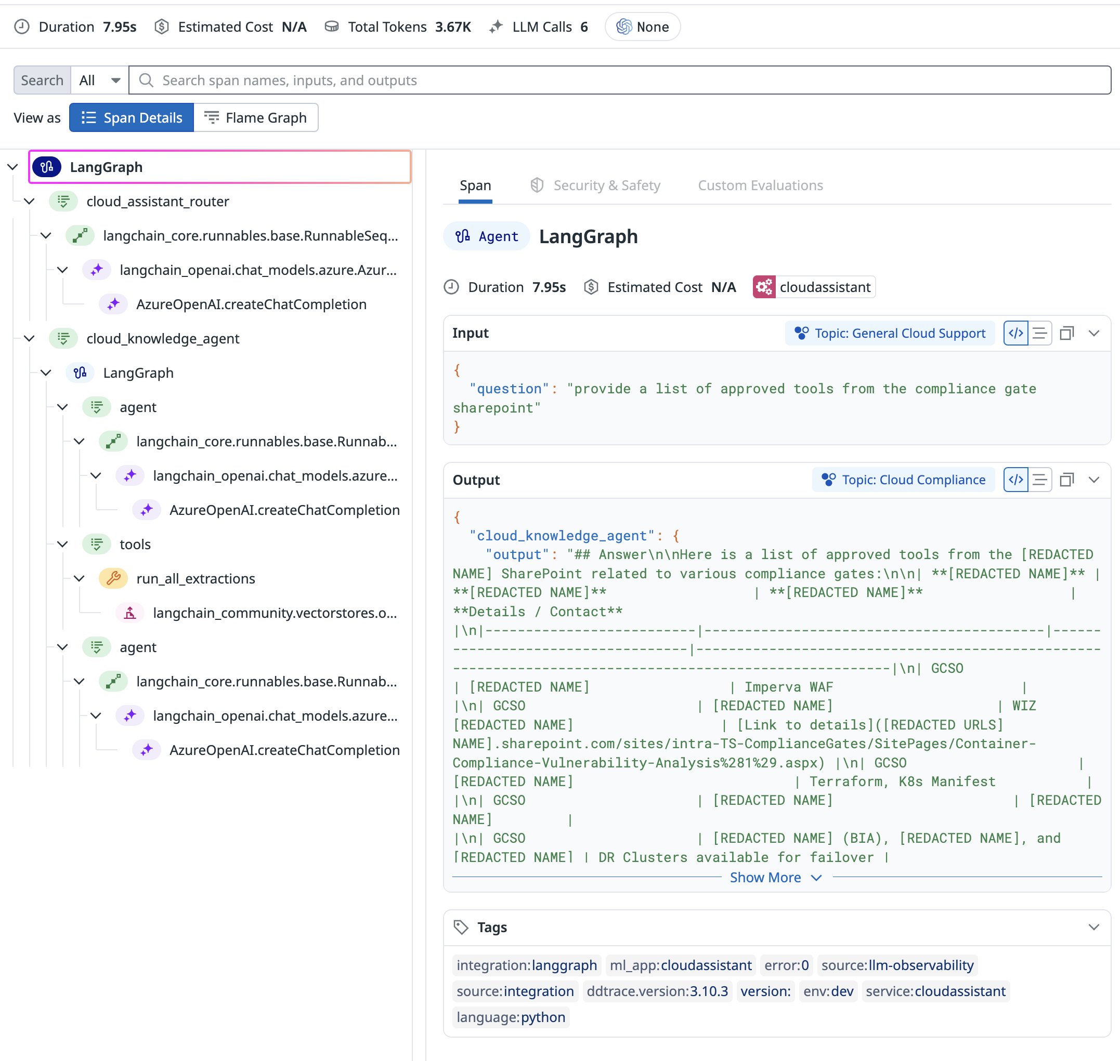
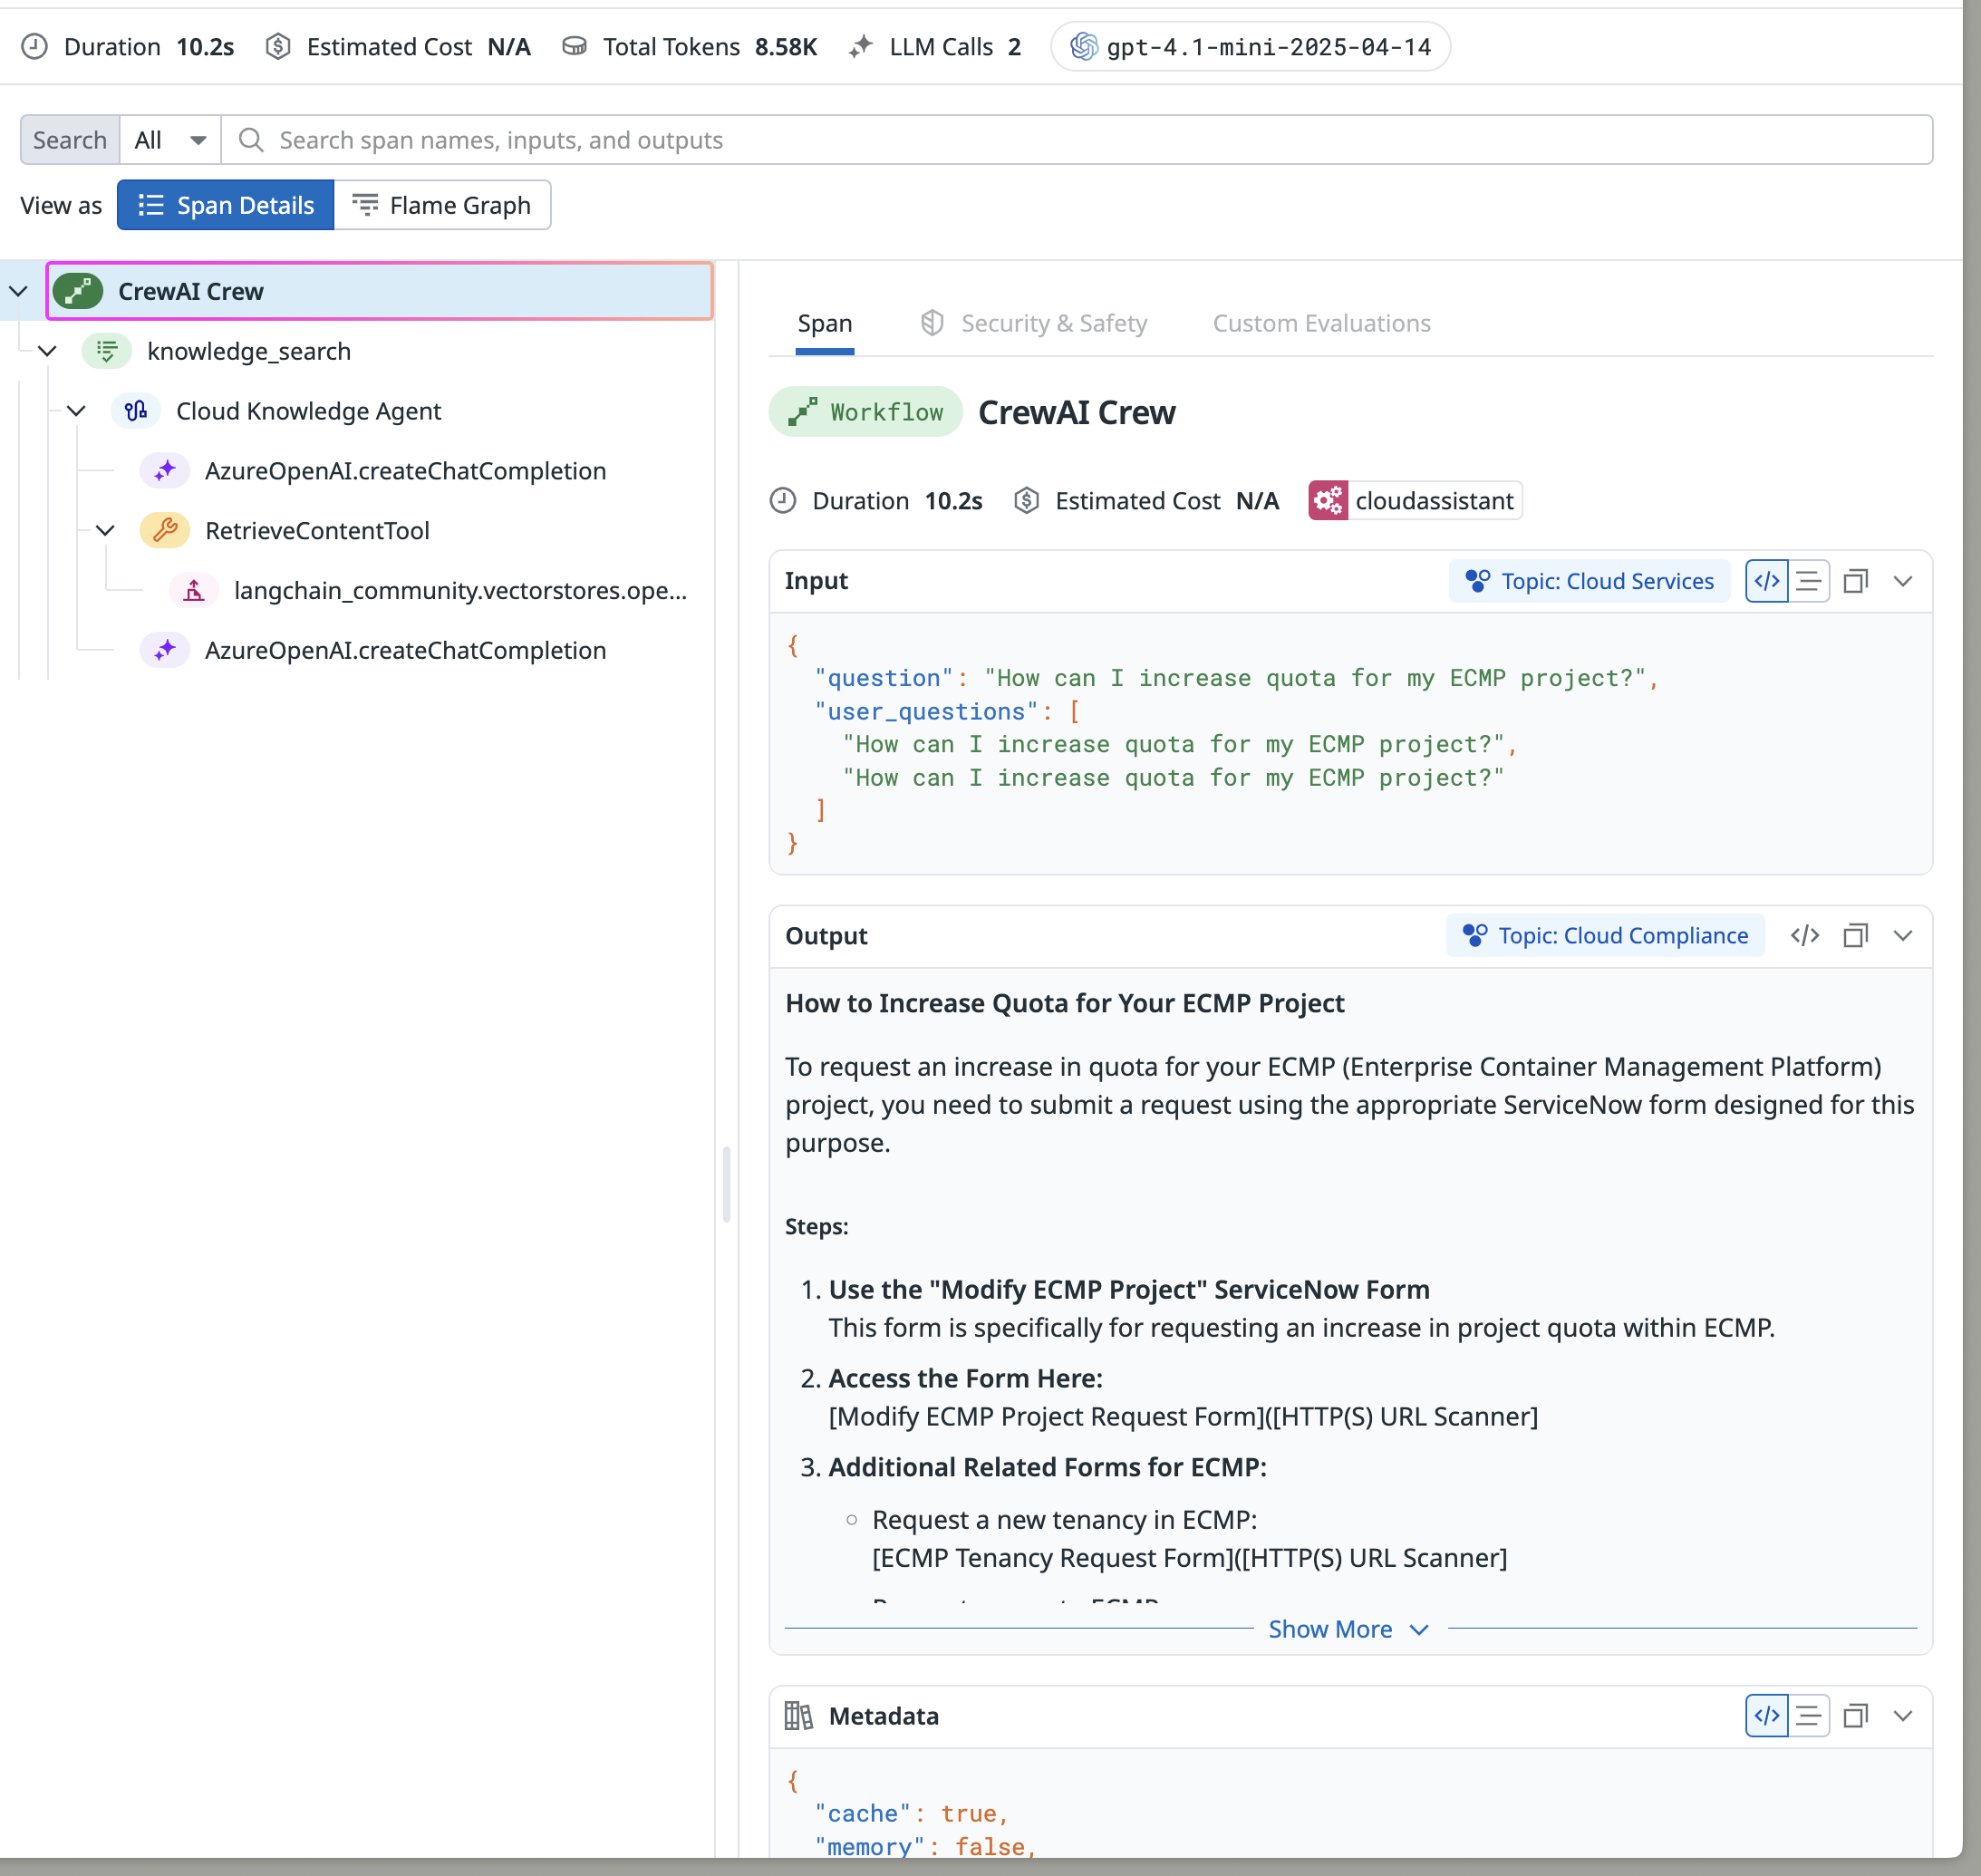

Slide 14
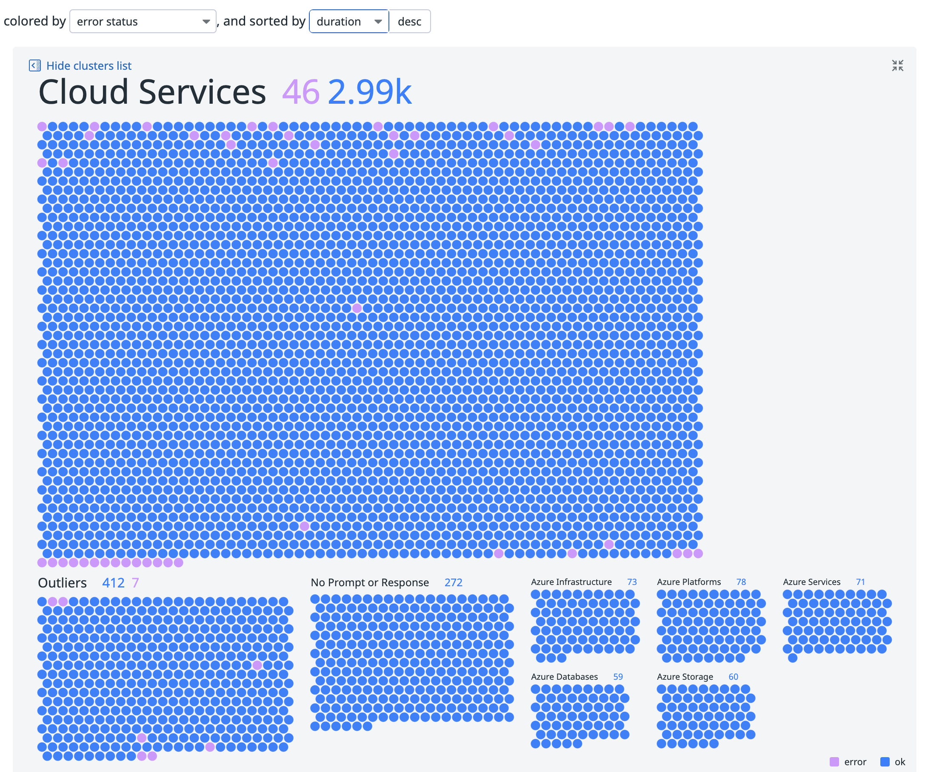
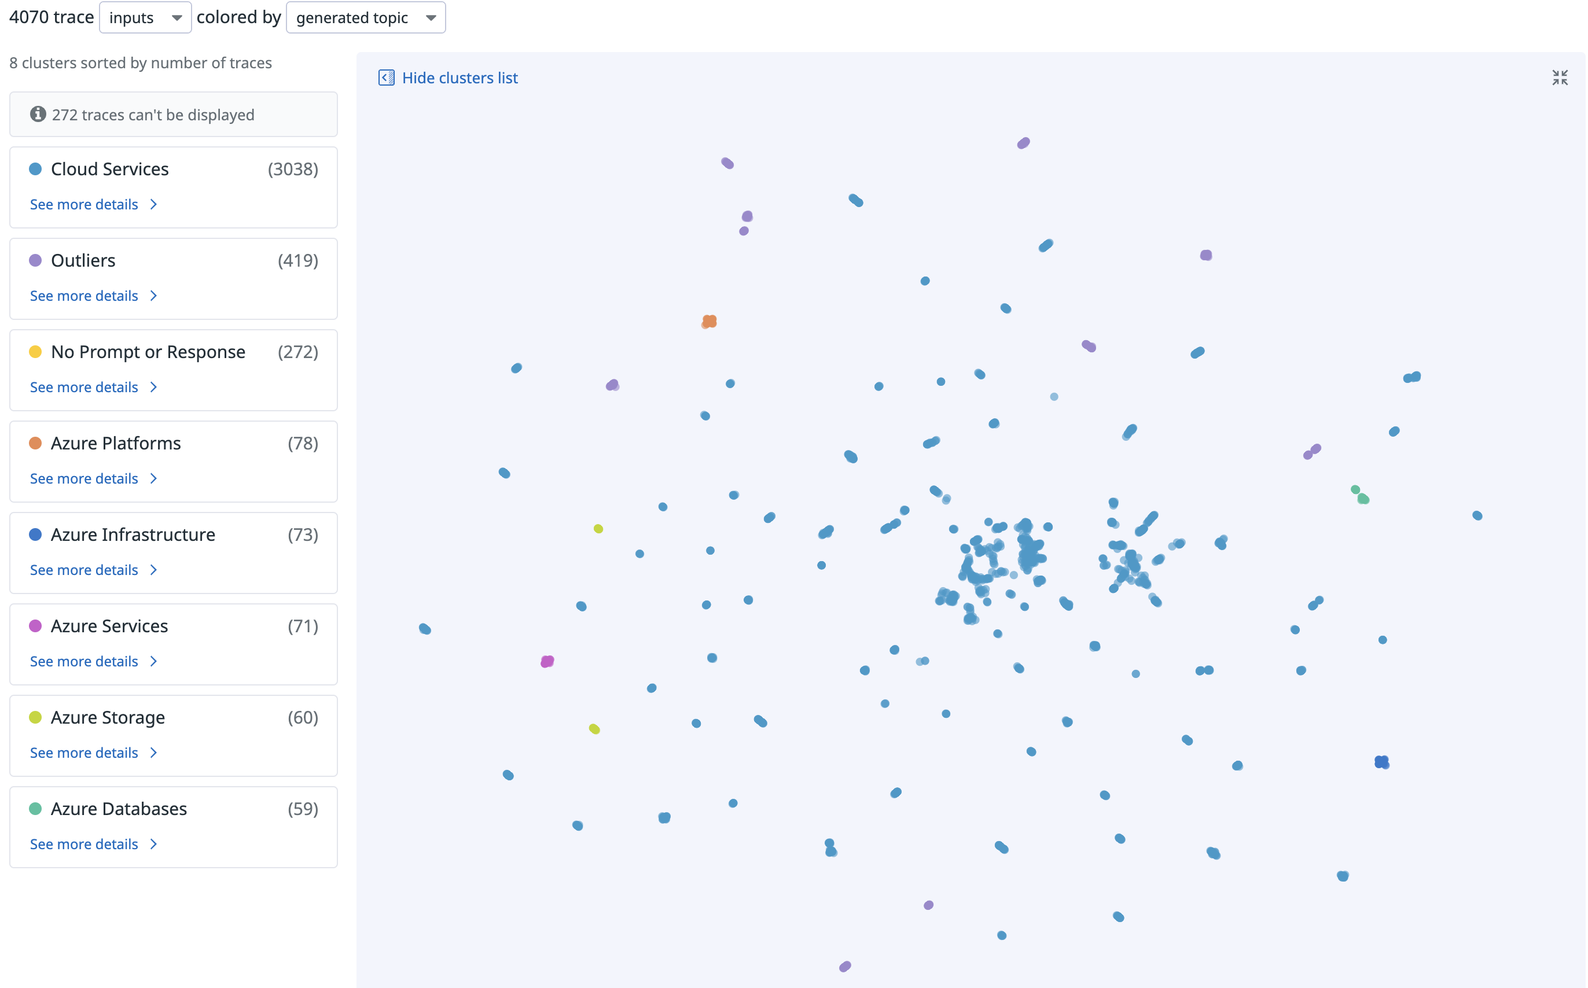
Clustering
4070 traces clustered
Where can I find the most asked questions now?

Slide 15
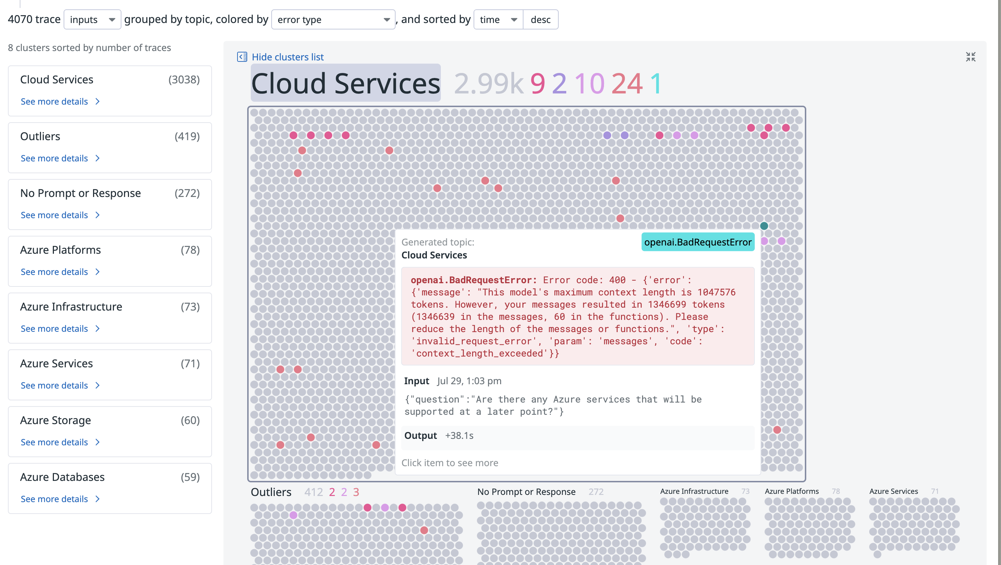
Clustering
Developer: Why did I get an error after almost 500 successful responses out of blue?
Note: Since traces are sorted by time, a line of same color shows that the error hasn’t been resolved.

Slide 16
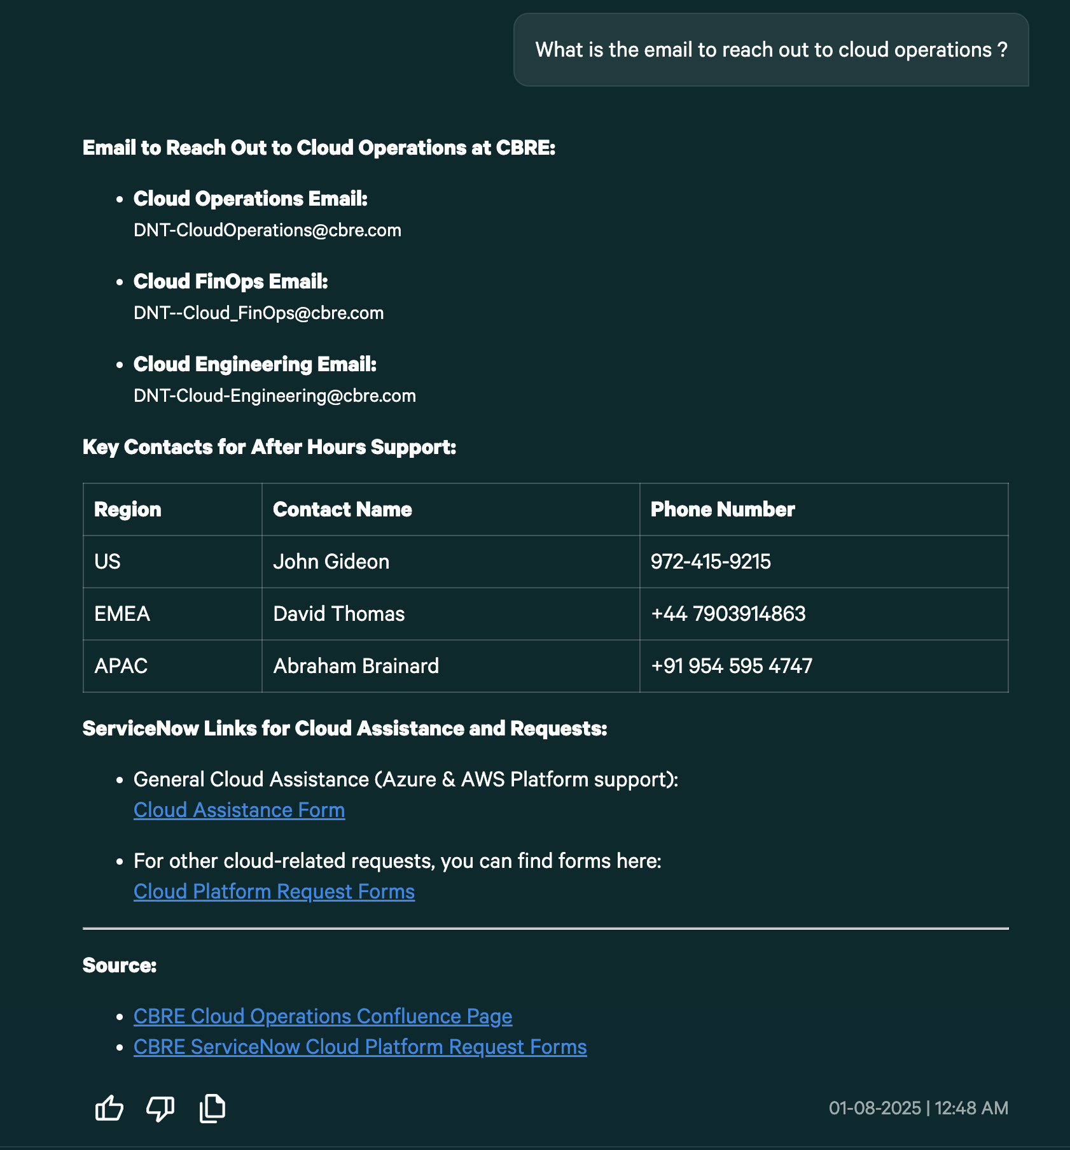
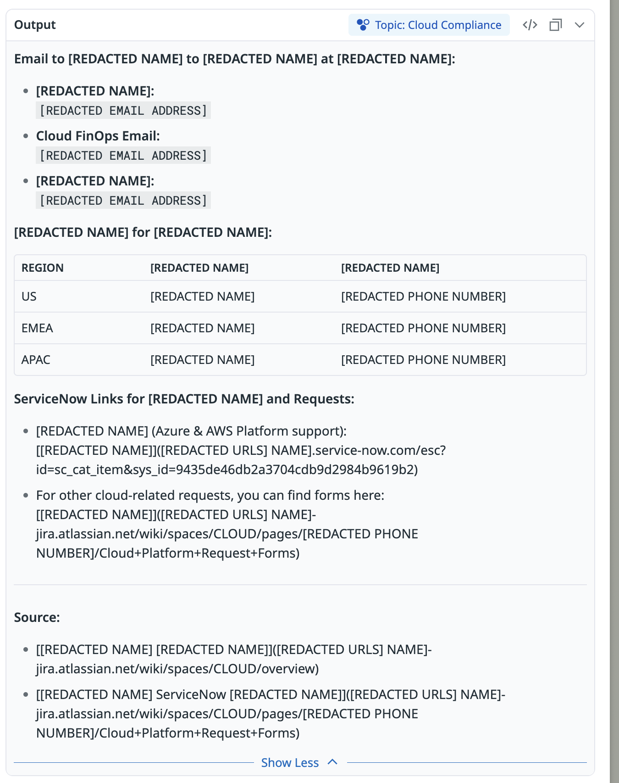
Redaction

Slide 17
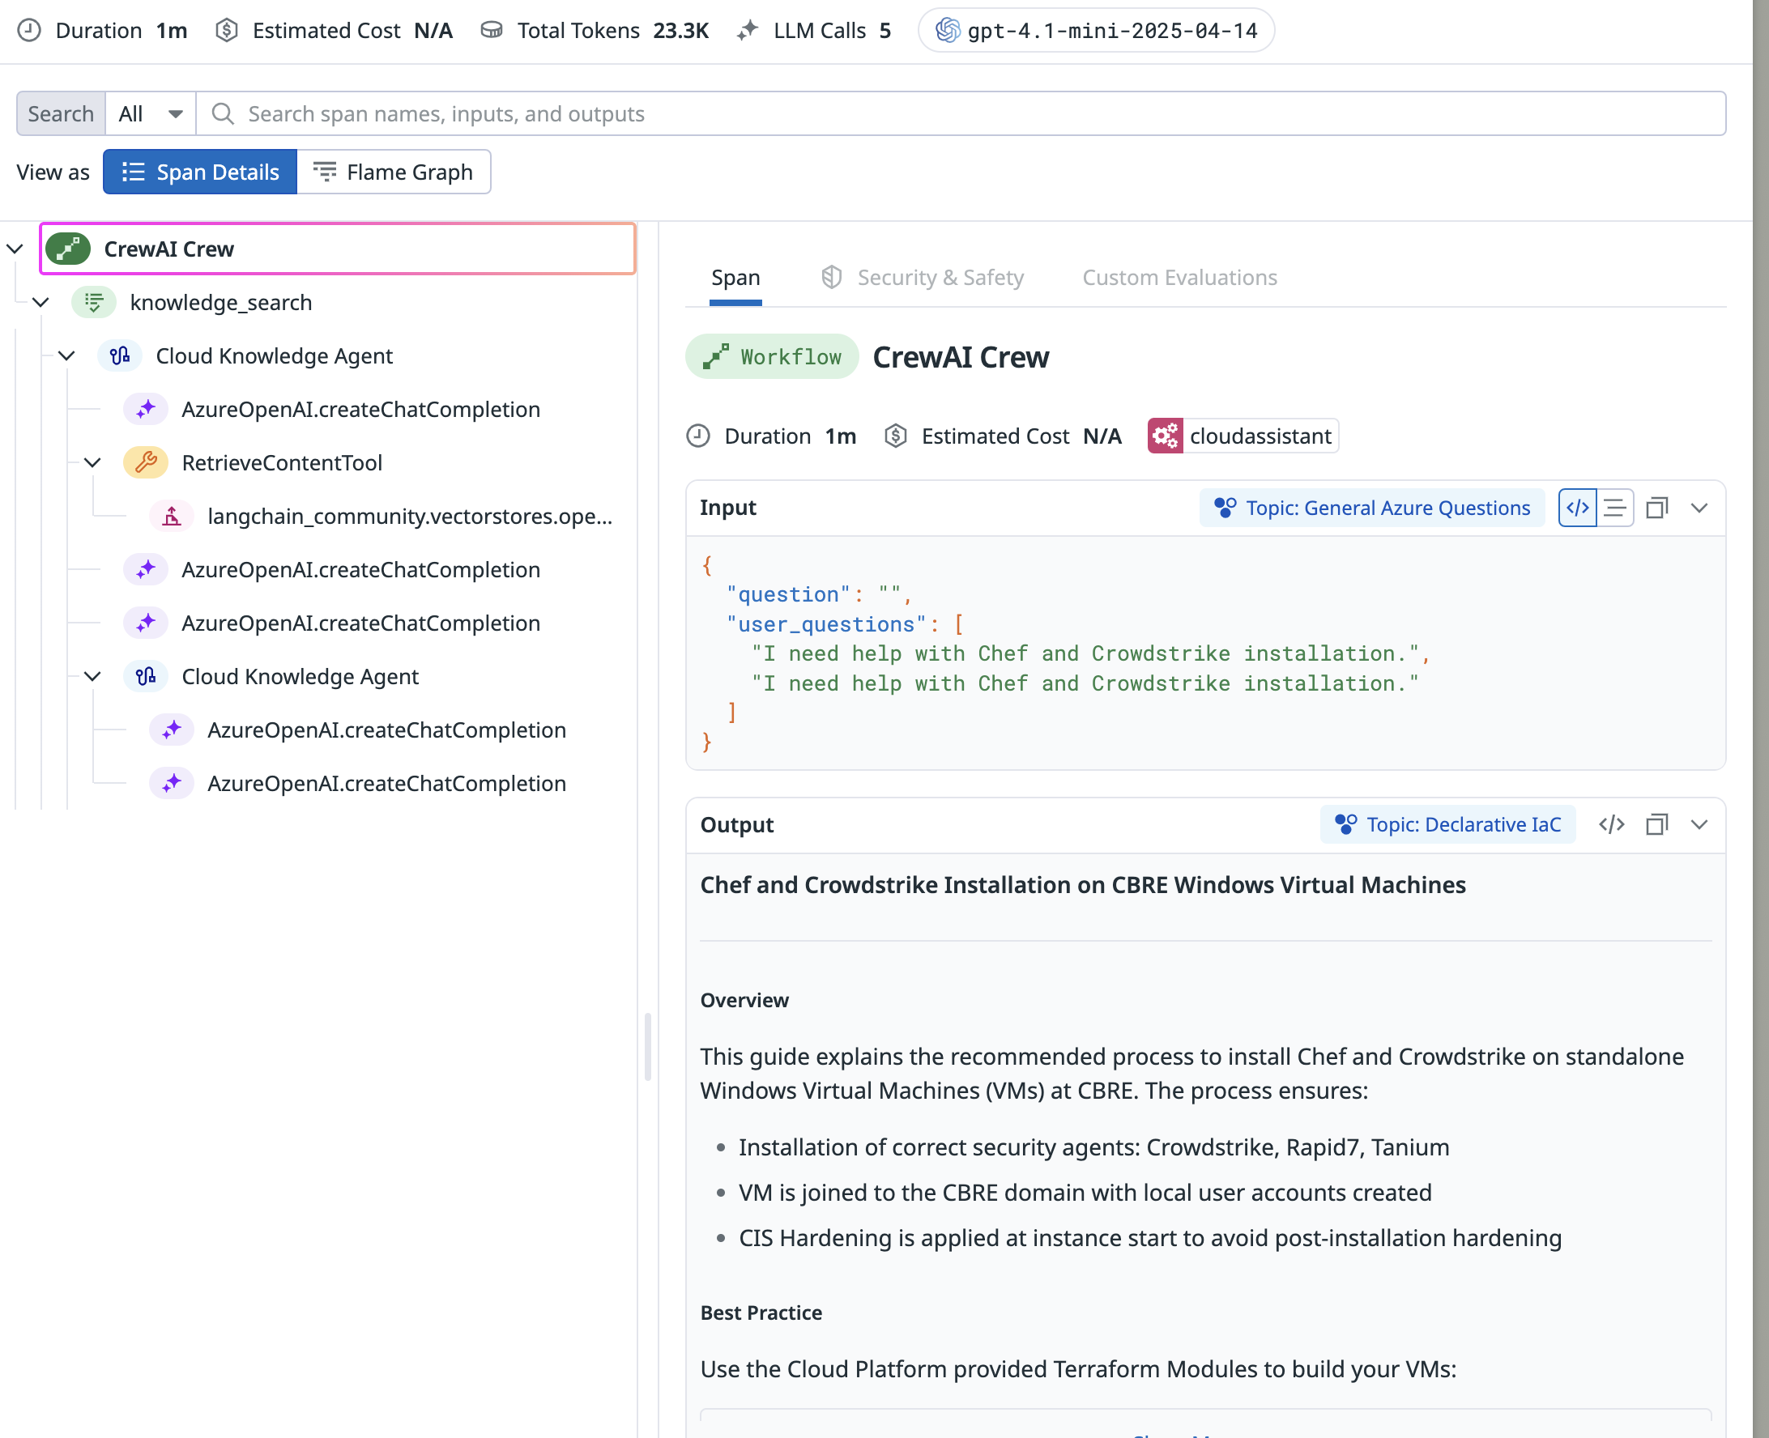
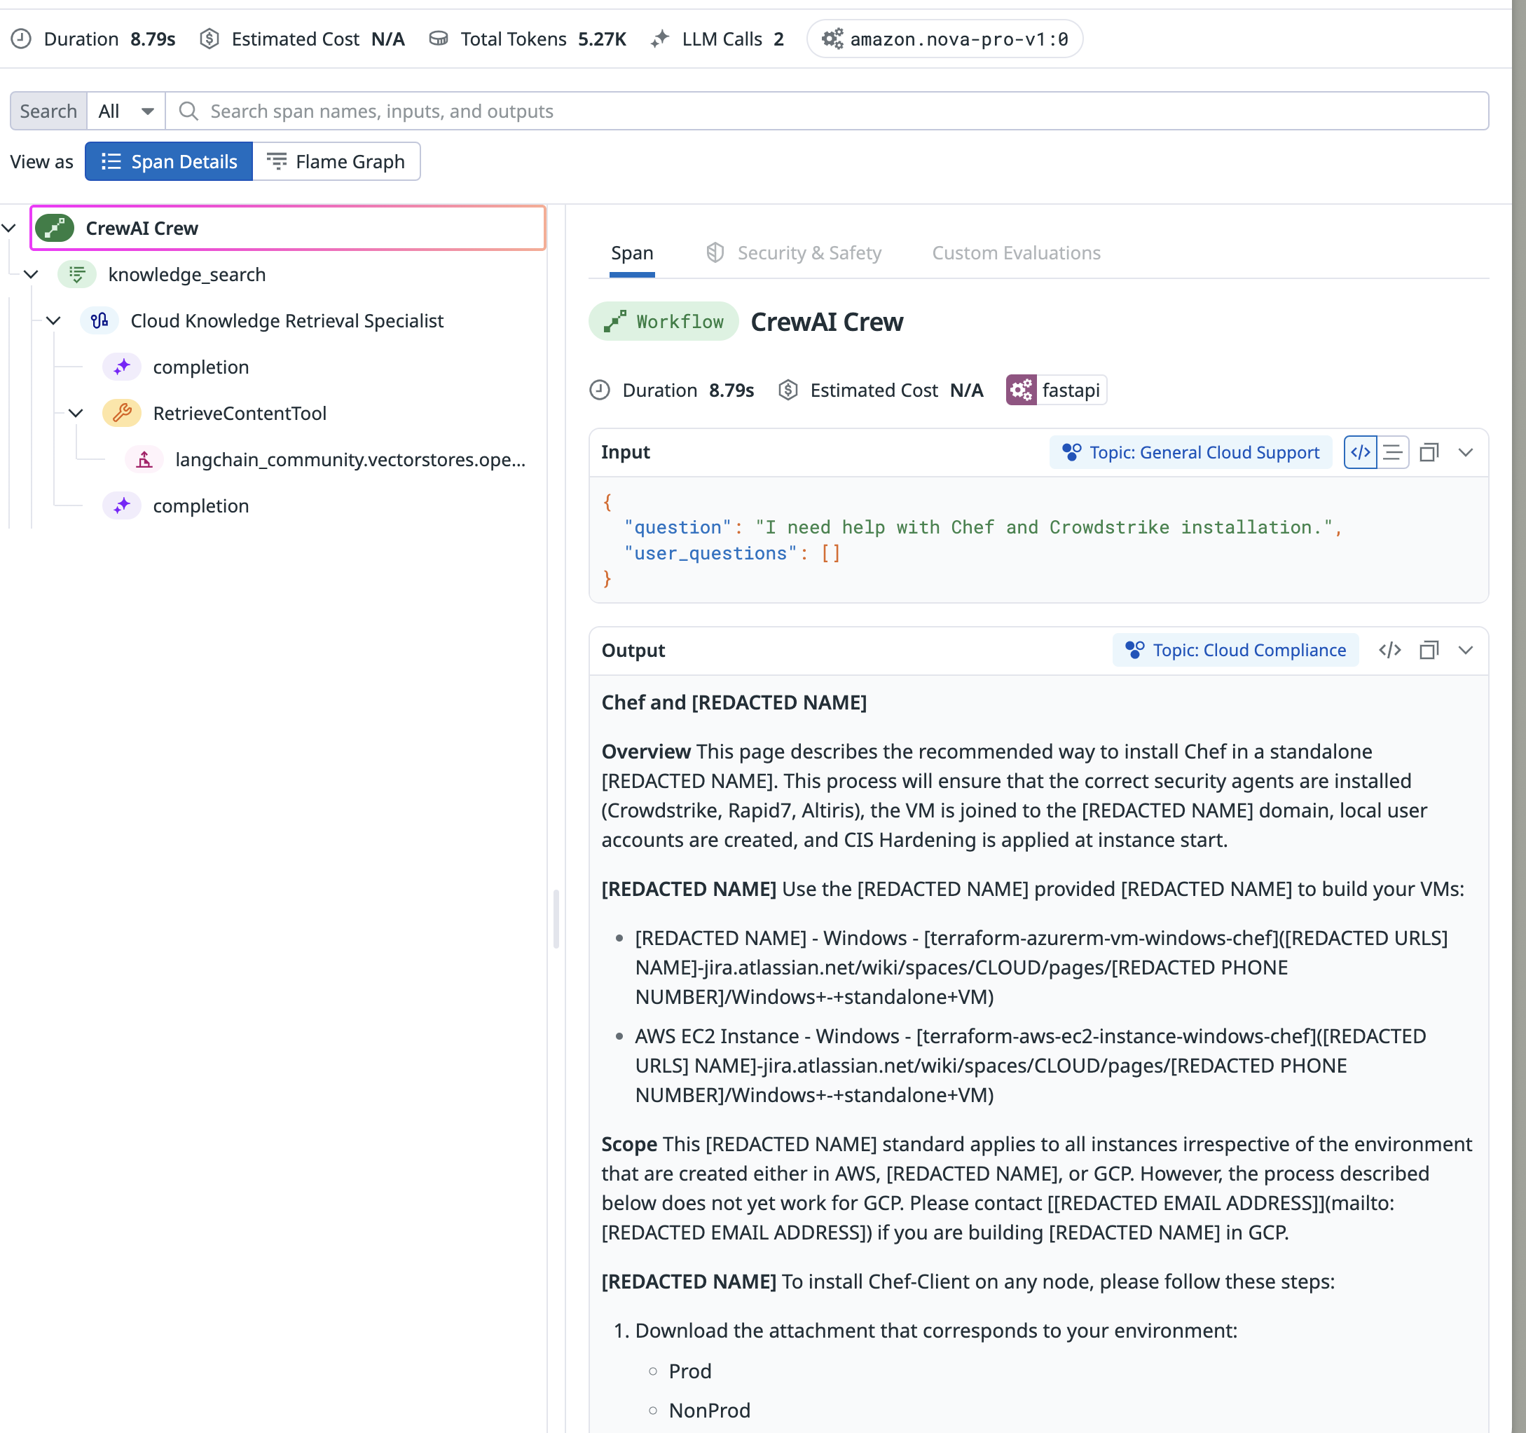
Latency Improvement from 1m to 9s

Slide 18
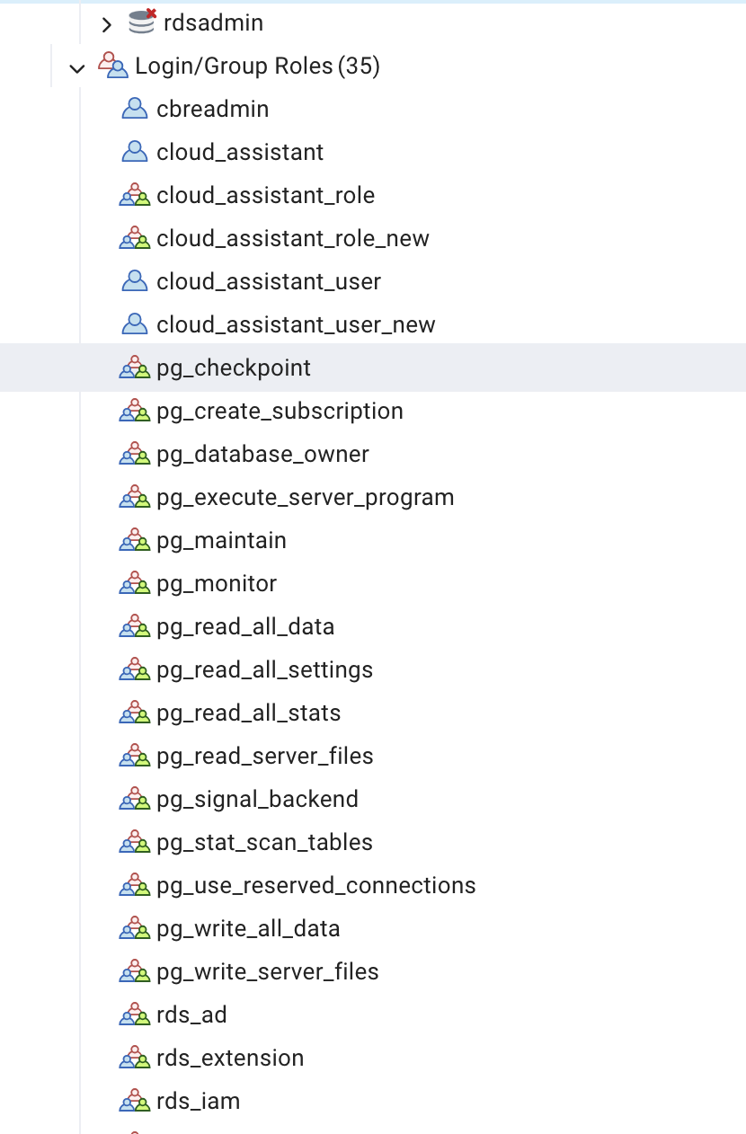
Creating user schema, roles and privileges for Rightsizing and Cloud assistant projects through PostgresSQL
2

Slide 19




Growth
01
Business
MY experience
Working with Datadog Team
Connect with Leaders
Presenting ideas
Working with UK, India team
02
02
Technical Learning
CrewAI
AgenticAI
LangGraph
Datadog
Kubernetes
RAGAS
LiteLLM
Azure Pipelines
Coralogix
03
01
03
Events
Table Tennis Tournament
D&T Intern Alumni Networking
Volunteering at Bonton Farms
Notes:
I learned a lot in my time here at CBRE from soft skills to technical sklls and everything in between. Some key skills I learned while working here was working with multiple people across multiple teams and even across multiple timezones. Additionally, I got to work with some cool, modern technologies like SnowFlake and working with the Google Maps API which really taught me a lot on the technical side of things. Finally, the people at CBRE were definitely the highlight of my time here. I want to shoutout my team and the interns who really made everyday loads of fun. My team was very welcoming from the beginning and Ive had some fun adventures getting food with them after work and visiting their homes and families. I’ve also picked up another skill I wasn’t expecting to learn in the internship, that being ping pong, which my team loves to play. The internship program has had a bunch of fun events too and I loved going to volunteer at UTD and see the younger generations having fun learning computer science as well. Overall Ive had a great time here and thank you so much to everyone on my team and my fellow interns and a special thanks to my manager Phani and Hayley for always being there.

Slide 20

Thank you.
Contact Info
Tel. +1 945 274 8719
kotrasrikar@gmail.com
LinkedIn:
John Gideon
Giri Sripati
Thilak Jayachandran
Martin, David
Gaur, Pradeep Thambusamy, Charles
Pallapothu, Rajesh
Kadiyala, Pavitra
Chettupalli, Sai Praveen
Hayley Murphy

Slide 21
Enhancing Cloud Operations x

Slide 22



Enhancing Cloud Operations x

Slide 23
Enhancing Cloud Operations x

Slide 24


AGENDA
Introduction
Enhancing Cloud Operations
Cost Optimization
Impact
Journey and Roadmap

Slide 25


Cost Optimization x

Slide 26


AGENDA
Introduction
Enhancing Cloud Operations
Cost Optimization
Impact
Journey and Roadmap

Slide 27
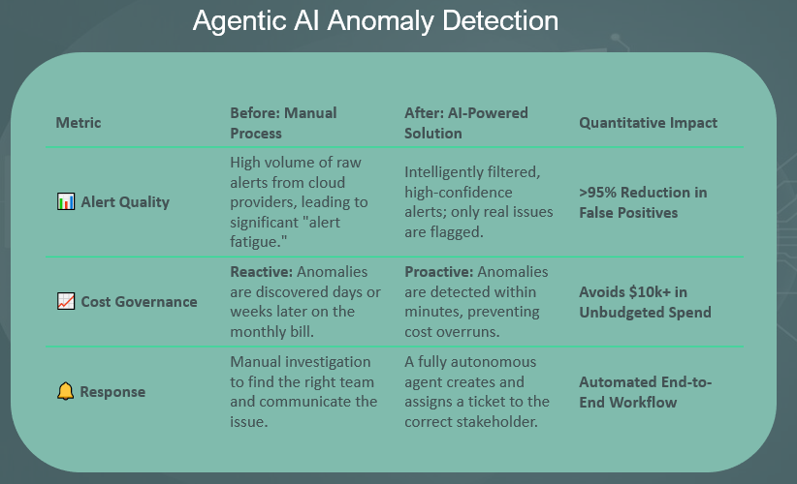
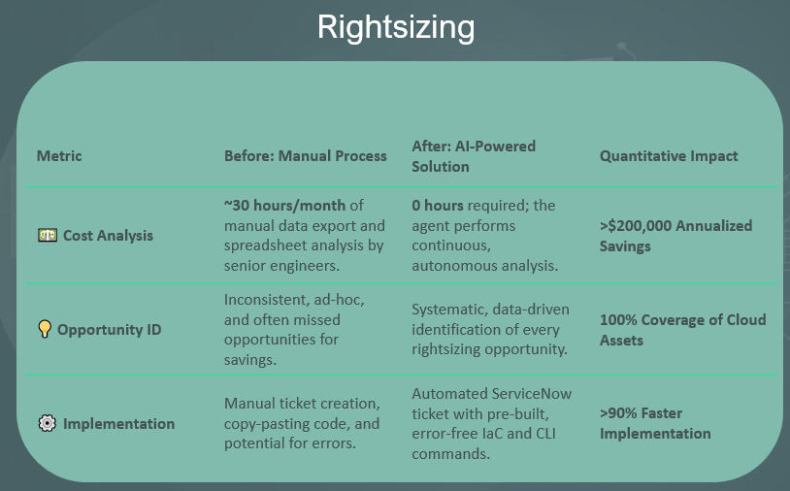
Impact x
Intelligent Cloud Assistant
Metric | Before: Manual Process | After: AI-Powered Solution | Quantitative Impact
🧑‍💻 IaC Generation | Hours of manual coding, researching standards, and fixing errors. | Seconds to generate a fully compliant, ready-to-use Terraform module. | >90% Reduction in Creation Time
🔎 Troubleshooting | Minutes to hours spent searching wikis, old tickets, and asking colleagues for help. | Instant, context-aware suggestions based on internal knowledge bases. | ~80% Faster Resolution
✅ Compliance | Manual peer reviews; high risk of human error and non-compliant deployments. | Automated checks ensure 100% compliance before deployment. | Eliminates Rework & Risk

Slide 28
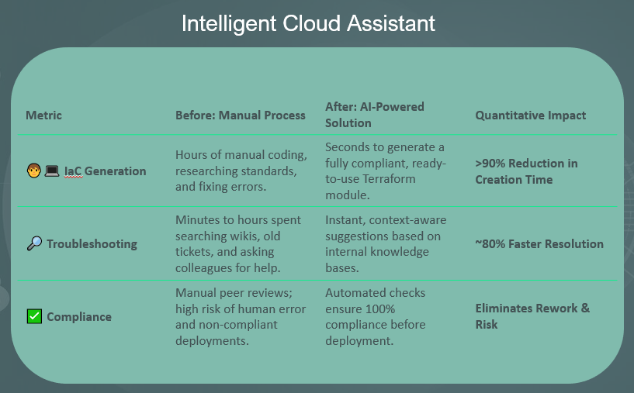
Impact x
Rightsizing
Metric | Before: Manual Process | After: AI-Powered Solution | Quantitative Impact
💵 Cost Analysis | ~30 hours/month of manual data export and spreadsheet analysis by senior engineers. | 0 hours required; the agent performs continuous, autonomous analysis. | >$200,000 Annualized Savings
💡 Opportunity ID | Inconsistent, ad-hoc, and often missed opportunities for savings. | Systematic, data-driven identification of every rightsizing opportunity. | 100% Coverage of Cloud Assets
⚙️ Implementation | Manual ticket creation, copy-pasting code, and potential for errors. | Automated ServiceNow ticket with pre-built, error-free IaC and CLI commands. | >90% Faster Implementation

Slide 29
Impact x
Agentic AI Anomaly Detection
Metric | Before: Manual Process | After: AI-Powered Solution | Quantitative Impact
📊 Alert Quality | High volume of raw alerts from cloud providers, leading to significant "alert fatigue." | Intelligently filtered, high-confidence alerts; only real issues are flagged. | >95% Reduction in False Positives
📈 Cost Governance | Reactive: Anomalies are discovered days or weeks later on the monthly bill. | Proactive: Anomalies are detected within minutes, preventing cost overruns. | Avoids $10k+ in Unbudgeted Spend
🔔 Response | Manual investigation to find the right team and communicate the issue. | A fully autonomous agent creates and assigns a ticket to the correct stakeholder. | Automated End-to-End Workflow

Slide 30


AGENDA
Introduction
Enhancing Cloud Operations
Agentic AI Anomaly Detection
Cost Optimization
Impact
Journey and Roadmap
Metric | Before: Manual Process | After: AI-Powered Solution | Quantitative Impact
📊 Alert Quality | High volume of raw alerts from cloud providers, leading to significant "alert fatigue." | Intelligently filtered, high-confidence alerts; only real issues are flagged. | >95% Reduction in False Positives
📈 Cost Governance | Reactive: Anomalies are discovered days or weeks later on the monthly bill. | Proactive: Anomalies are detected within minutes, preventing cost overruns. | Avoids $10k+ in Unbudgeted Spend
🔔 Response | Manual investigation to find the right team and communicate the issue. | A fully autonomous agent creates and assigns a ticket to the correct stakeholder. | Automated End-to-End Workflow

Slide 31

Journey and Roadmap x
June 2025
June 2025
June 2025
June 2025
June 2025

Slide 33
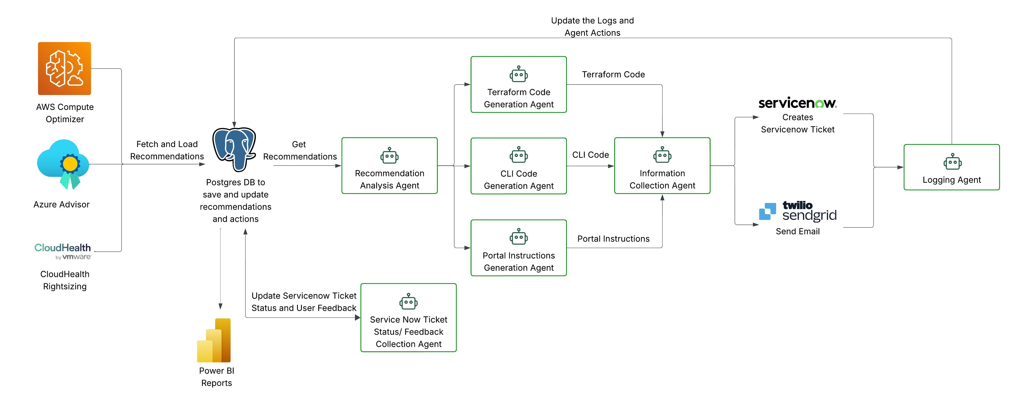
Data flow diagram | Agentic AI Anomaly Detection

Slide 36
Introduction x
Srikar Kotra
MS in Computer Science, University of Texas at Dallas Graduated May 2025 Hometown: India
Software Engineer Intern
Software Engineering Intern, Team: Data Protection
Manager: Hailey Phillips, Mentor: DeVynn Mingo
Football: The only place where I slow down… but only to score goals. Gaming: If there’s a leaderboard, I’m aiming for the top. Staying Active: Energy level: 200%. Sitting still? Not my thing.
"I’m so active that even my coffee can’t keep up with me."

Slide 40
AGENDA
Introduction
Enhancing Cloud Operations
Cost Optimization
Impact
Journey and Roadmap

Slide 41
Impact x

Slide 42
AGENDA
Introduction
Enhancing Cloud Operations
Cost Optimization
Impact
Journey and Roadmap

Slide 44
Introduction x
Education
Graduated from UCLA March 2024
B.S. Civil Engineering
Srikar Kotra
Software Engineer Intern

Slide 45
Introduction x
Happy to Chat About:
Orange County, CA
Basketball, golf
Sustainable construction
Traveling
Srikar Kotra
Software Engineer Intern

Slide 46
Introduction x
Current Role at CBRE
Product Management Intern
Srikar Kotra
Software Engineer Intern

Slide 47
Introduction x
Srikar Kotra
Software Engineer Intern

